Slide 1
Analysis of recent political rbk news
Nikishin Georgy BASB-211

Slide 2
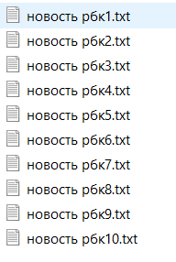
DATA
10 txt files, containing news from RBK about political situation on the date 31.03.2022

Slide 3

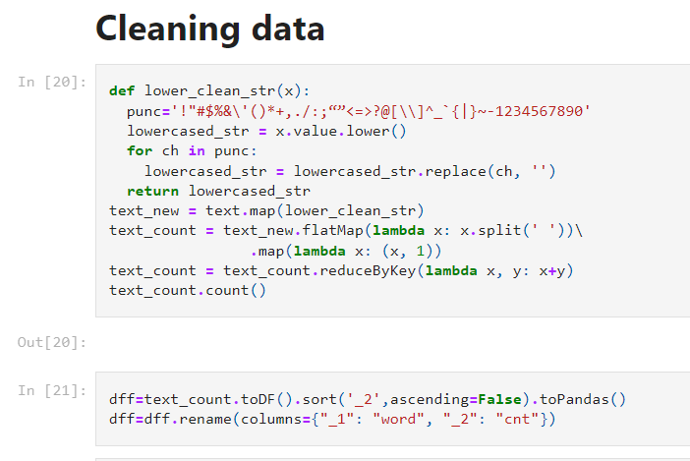
Data cleaning
lowercasing
removing duplicates
removing stop-words and punctuations

Slide 4
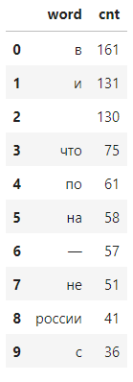
Top 10 most popular words

Slide 5

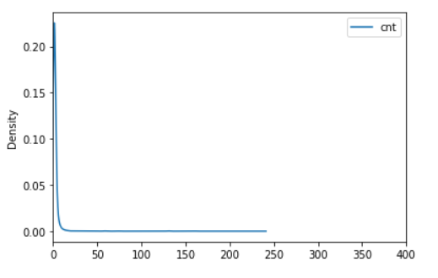
Visualization

